Slide 1
REBEL FOODS ANALYSIS
Welcome to our presentation on applying strategic frameworks to analyze the leading snack food brand, Rebel. We'll dive deep into their business, market position, and growth opportunities.
by Kavin Sathya

Slide 2
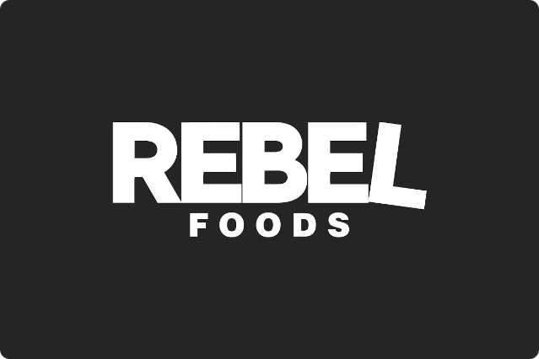
Introduction to Rebel
Rebel is a rapidly growing Indian food tech company that operates a network of cloud kitchens and food brands. They are transforming the way people discover and enjoy delicious, affordable meals.

Slide 3
Porter's Five Forces Analysis of Rebel
Supplier Power
Buyer Power
Competitive Rivalry
Rebel's strong supply chain and vendor relationships give them leverage over suppliers.
Rebel's diverse customer base and brand loyalty reduce buyer power.
Rebel faces intense competition from other food delivery platforms and cloud kitchens.

Slide 4

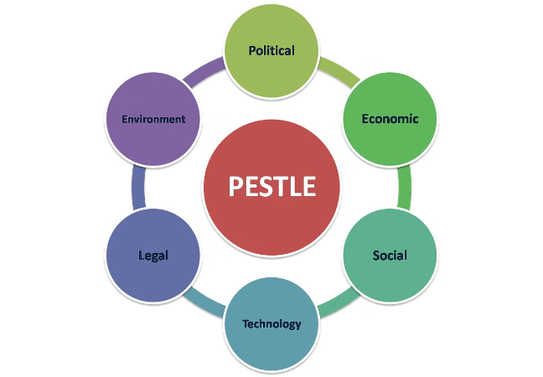
PESTLE Analysis for Rebel
Political
Favorable government policies supporting startups and digitization.
Economic
Rising disposable incomes and growing demand for convenience foods.
Social
Changing consumer preferences towards healthy or convenient food options
Technological
Advancements in cloud kitchens, AI-driven operations, and online ordering
Legal
Food safety regulations and compliance standards
Environmental
Sustainable sourcing of ingredients and packaging materials

Slide 5
SWOT Analysis of Rebel
Strengths
Weaknesses
Strong brand recognition, technology-driven operations, and efficient supply chain.
Reliance on third-party delivery platforms and high customer acquisition costs.
Opportunities
Threats
Expansion into new cuisines, partnerships with celebrity chefs, and international growth.
Intense competition, changing consumer preferences, and regulatory challenges.

Slide 6
Marketing Mix Model Application for Rebel
Product
Rebel offers a diverse menu of high-quality, crave-worthy dishes across multiple food brands.
Price
Rebel's pricing strategy aims to be affordable for the mass market while maintaining profitability.
Promotion
Rebel utilizes digital marketing, influencer partnerships, and innovative loyalty programs to engage customers.

Slide 7
The 3 C's Framework for Rebel
Company
Rebel's strong brand, technology-driven operations, and innovative business model.
Collaborators
Rebel's partnerships with delivery platforms, food suppliers, and technology providers.
Customers
Rebel's deep understanding of their target audience's preferences and behaviors.

Slide 8

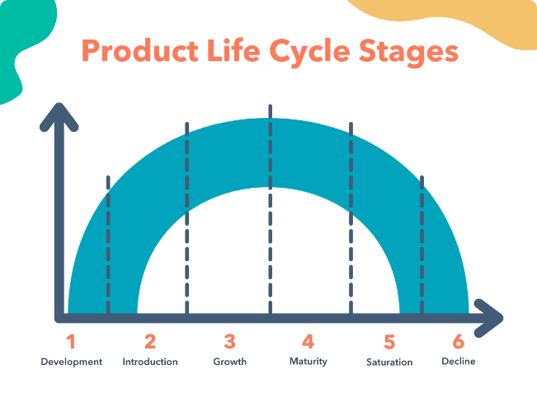
Product Life Cycle Analysis
for Rebel
Introduction
Rebel launched its first cloud kitchen brand, Faasos, in 2011 to provide convenient and affordable meals.
Growth
Rebel rapidly expanded its portfolio of food brands and opened new cloud kitchens across India.
Maturity
Rebel has become a dominant player in the online food delivery market, maintaining strong brand loyalty.

Slide 9

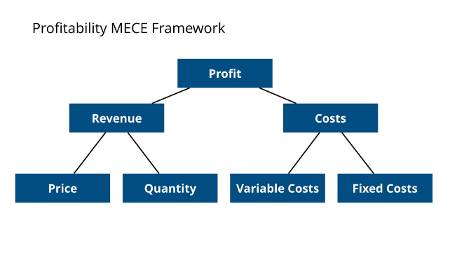
MECE Framework for Rebel
Mutually Exclusive
Rebel's diverse brand portfolio caters to different customer segments and cuisines.
Collectively Exhaustive
Rebel's offerings cover a wide range of meal options, from breakfast to late-night snacks.
Easy to Understand
Rebel's menu and ordering process are designed to be user-friendly and intuitive.

Slide 10

Thank you for your time and attention. We hope this presentation has provided you with a comprehensive understanding of Rebel's strategic positioning and the various frameworks used to analyze its business.

